Slide 1

CCO Modernization Roadmap
John Beverley
President, National Center for Ontological Research
Assistant Professor, University at Buffalo
Associate Director, Institute of Artificial Intelligence and Data Science

Slide 2
Outline
CCO Governance Board & NCOR
CCO Modernization Effort
CCO Future Release Strategy

Slide 3
Outline
CCO Governance Board & NCOR
CCO Modernization Effort
CCO Future Release Strategy

Slide 4
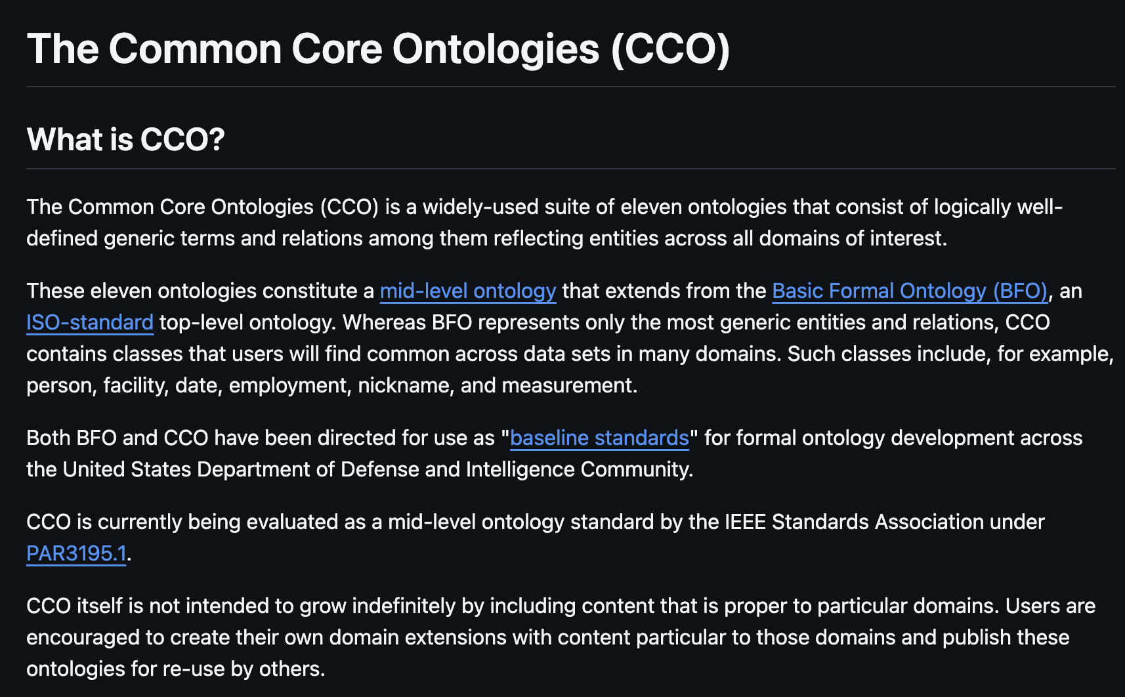
https://github.com/CommonCoreOntology/CommonCoreOntologies

Slide 5
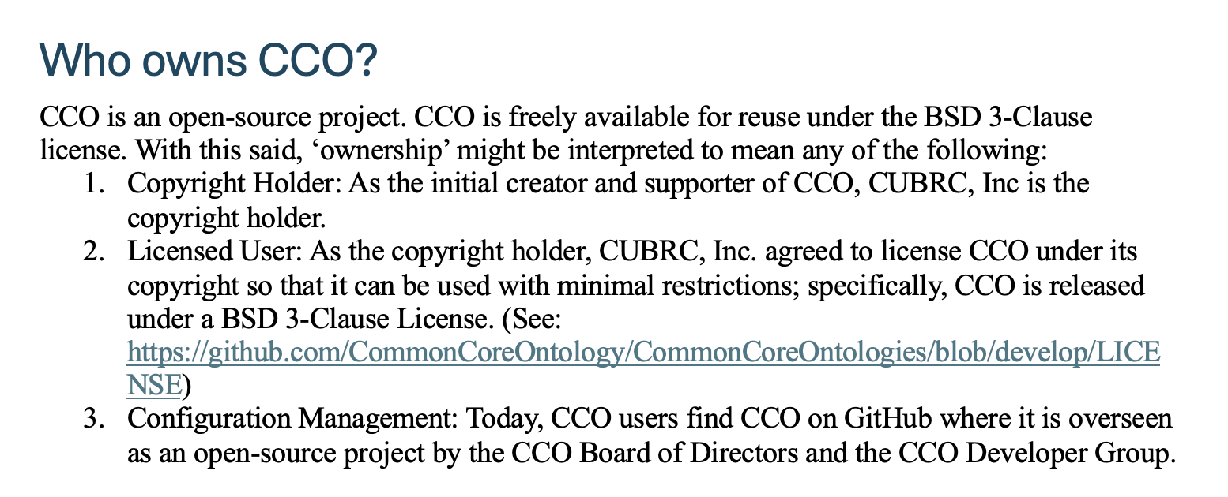

Slide 6
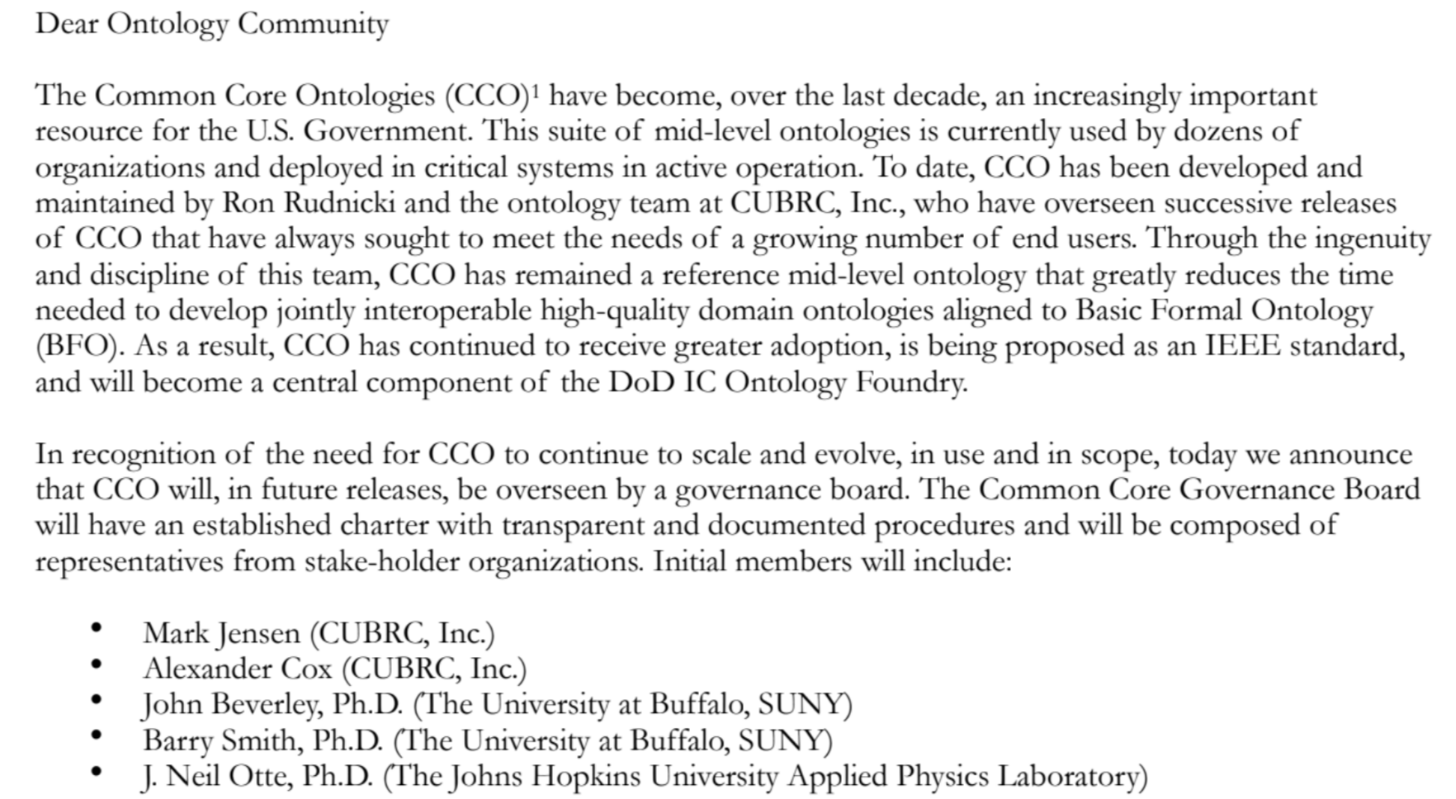
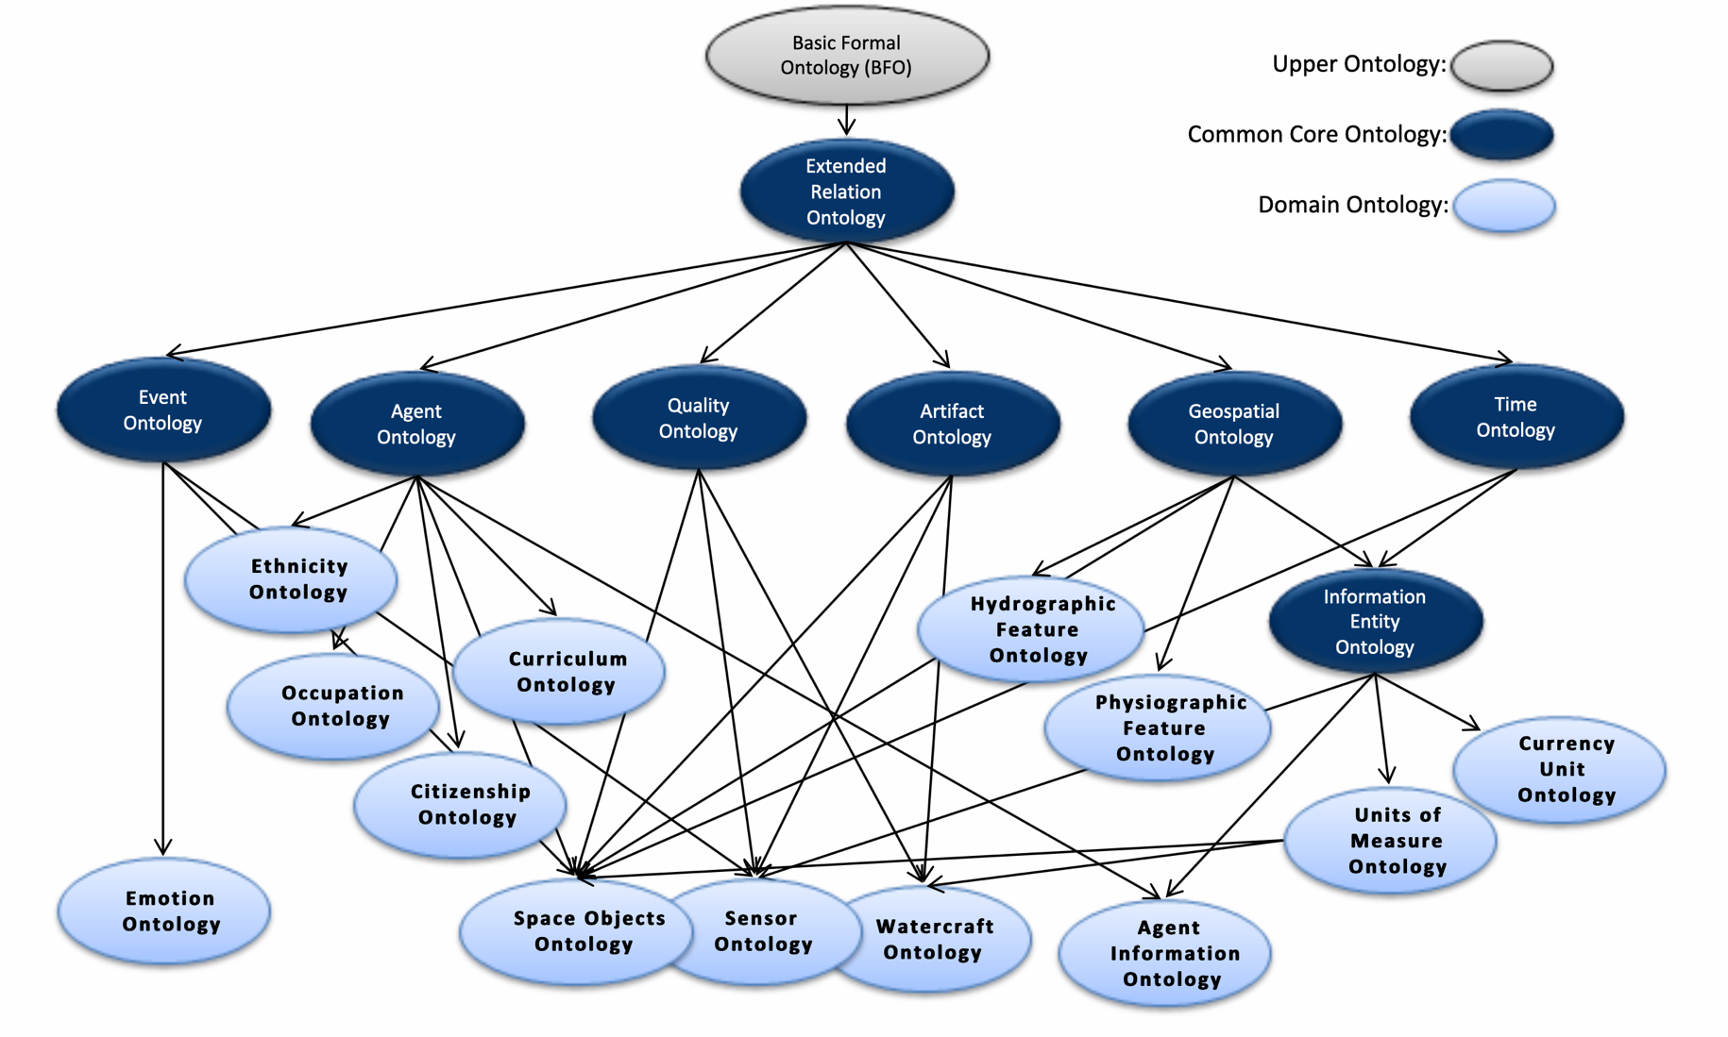
CCO Governance Board

Slide 7
CCO Governance Board
CCO Board of Directors
US Customs and Border Protection

Slide 8

NCOR 501(c)3
Established as a non-profit at the end of 2024
Board of Directors: Barry Smith & John Beverley
Accepts donations, service contracts, conference hosting, etc.
Recently, funded by USAF Air Combat Command to mature CCO into a stable artifact

Slide 9
CCO Governance Board & NCOR
Overlapping membership (Barry & John); John leading CCO modernization effort for NCOR
As with any changes to CCO, updates ultimately go through governance board members
For 2.1 release, NCOR coordinated updates to repositories and artifacts
NCOR to coordinate directly with CCO Developer Group for later releases

Slide 10
Outline
CCO Governance Board & NCOR
CCO Modernization Effort
CCO Future Release Strategy

Slide 11
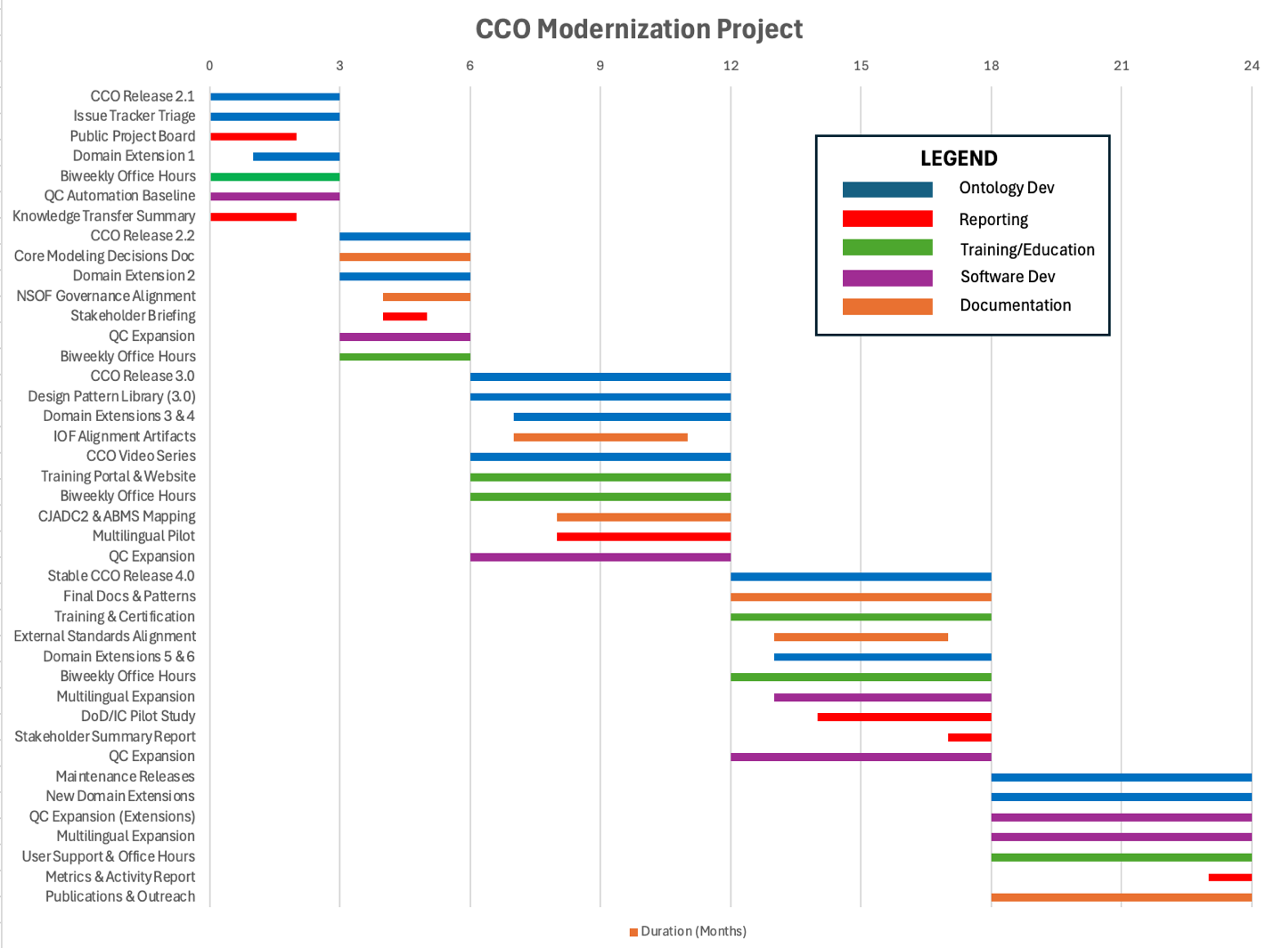

Slide 13
ID | Deliverable | Description | Acceptance Criteria
1A-1 | CCO Release 2.1 | 2.1 release of CCO reflecting prioritized fixes, corrections, and updates identified during transition | Release published with version tag, release notes, and reproducible build
1A-2 | Issue Tracker Triage | Systematic review of existing GitHub issues, including resolution, deferral, or closure with rationale | ≥70–80% of legacy issues resolved or dispositioned; labels standardized
1A-3 | Public Project Board | GitHub Projects board tracking milestones, issues, and releases | Board publicly accessible and updated weekly
1A-4 | Domain Extension 1 | At least one domain-specific extension module scoped, implemented, and integrated with core CCO | Module versioned, documented, and released alongside CCO 2.1 and QC-covered
1A-5 | Biweekly Office Hours | Regular stakeholder support sessions addressing modeling, usage, and transition questions | Sessions held; questions documented and summarized, hosted on website
1A-6 | QC Automation Baseline | Initial CI/CD pipeline implementing automated ontology quality checks (OWL, SHACL, SPARQL, etc.) | Automated checks run on PRs and main branch

Slide 14
ID | Deliverable | Description | Acceptance Criteria
1A-1 | CCO Release 2.1 | 2.1 release of CCO reflecting prioritized fixes, corrections, and updates identified during transition | Release published with version tag, release notes, and reproducible build
1A-2 | Issue Tracker Triage | Systematic review of existing GitHub issues, including resolution, deferral, or closure with rationale | ≥70–80% of legacy issues resolved or dispositioned; labels standardized
1A-3 | Public Project Board | GitHub Projects board tracking milestones, issues, and releases | Board publicly accessible and updated weekly
1A-4 | Domain Extension 1 | At least one domain-specific extension module scoped, implemented, and integrated with core CCO | Module versioned, documented, and released alongside CCO 2.1 and QC-covered
1A-5 | Biweekly Office Hours | Regular stakeholder support sessions addressing modeling, usage, and transition questions | Sessions held; questions documented and summarized, hosted on website
1A-6 | QC Automation Baseline | Initial CI/CD pipeline implementing automated ontology quality checks (OWL, SHACL, SPARQL, etc.) | Automated checks run on PRs and main branch

Slide 15
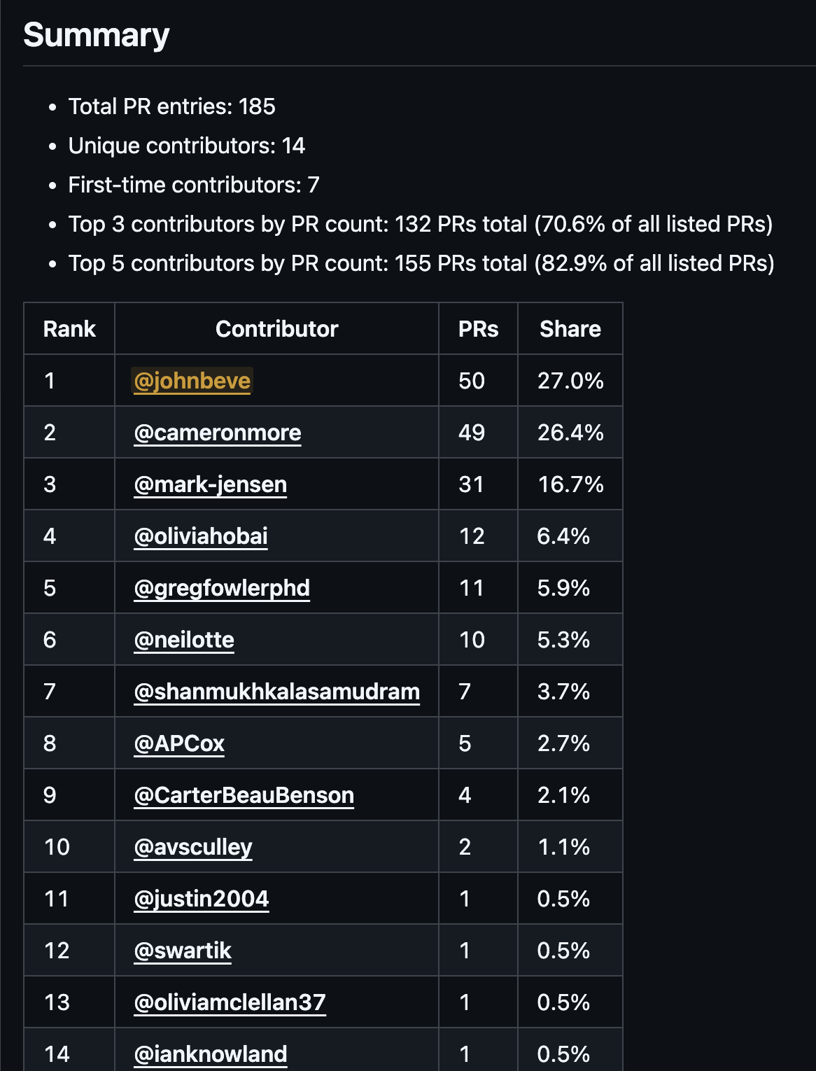
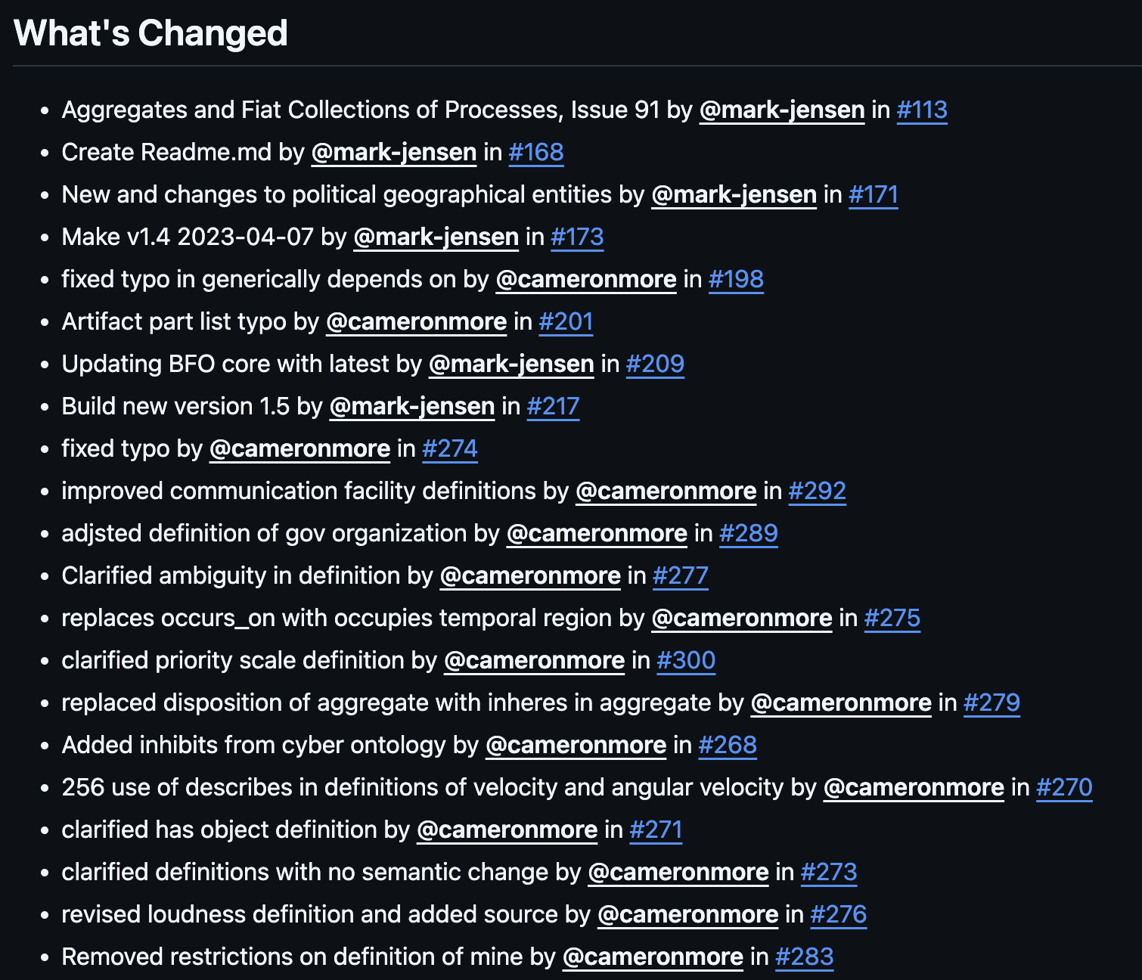
CCO 2.1
https://github.com/CommonCoreOntology/CommonCoreOntologies/releases/tag/v2.1

Slide 16
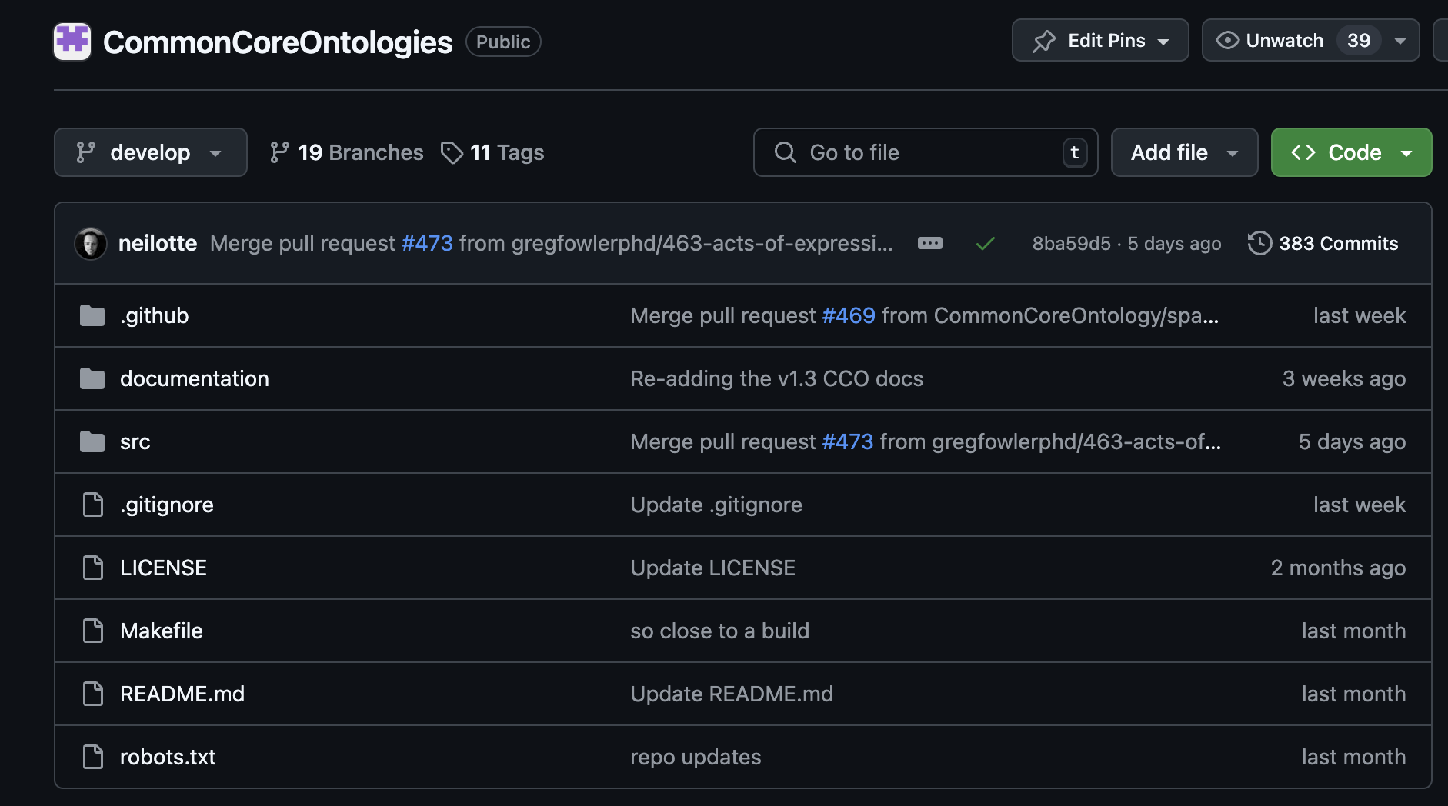

Slide 19
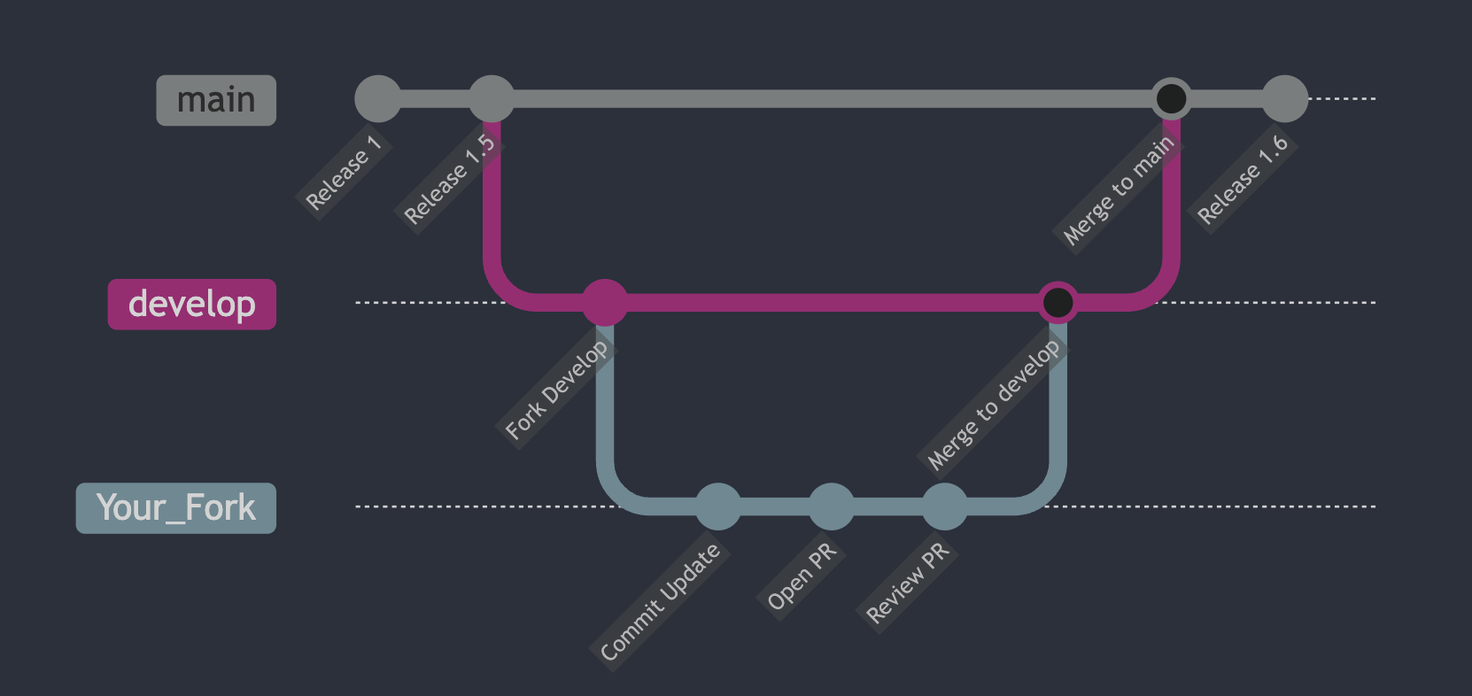


Slide 20
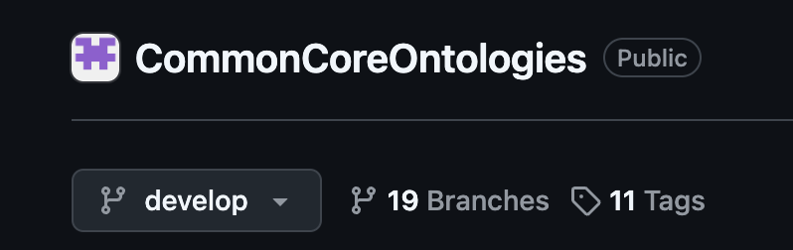

Slide 21
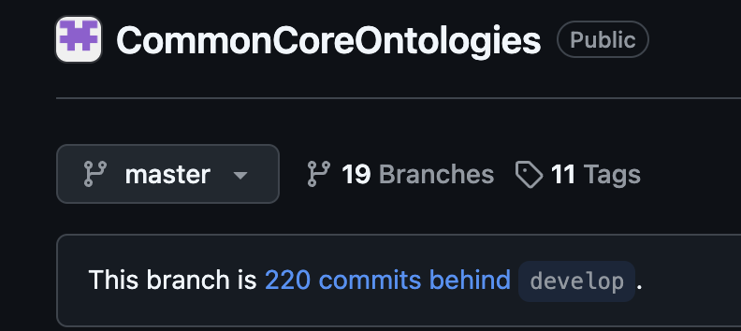

Slide 23
ID | Deliverable | Description | Acceptance Criteria
1A-1 | CCO Release 2.1 | 2.1 release of CCO reflecting prioritized fixes, corrections, and updates identified during transition | Release published with version tag, release notes, and reproducible build
1A-2 | Issue Tracker Triage | Systematic review of existing GitHub issues, including resolution, deferral, or closure with rationale | ≥70–80% of legacy issues resolved or dispositioned; labels standardized
1A-3 | Public Project Board | GitHub Projects board tracking milestones, issues, and releases | Board publicly accessible and updated weekly
1A-4 | Domain Extension 1 | At least one domain-specific extension module scoped, implemented, and integrated with core CCO | Module versioned, documented, and released alongside CCO 2.1 and QC-covered
1A-5 | Biweekly Office Hours | Regular stakeholder support sessions addressing modeling, usage, and transition questions | Sessions held; questions documented and summarized, hosted on website
1A-6 | QC Automation Baseline | Initial CI/CD pipeline implementing automated ontology quality checks (OWL, SHACL, SPARQL, etc.) | Automated checks run on PRs and main branch

Slide 24
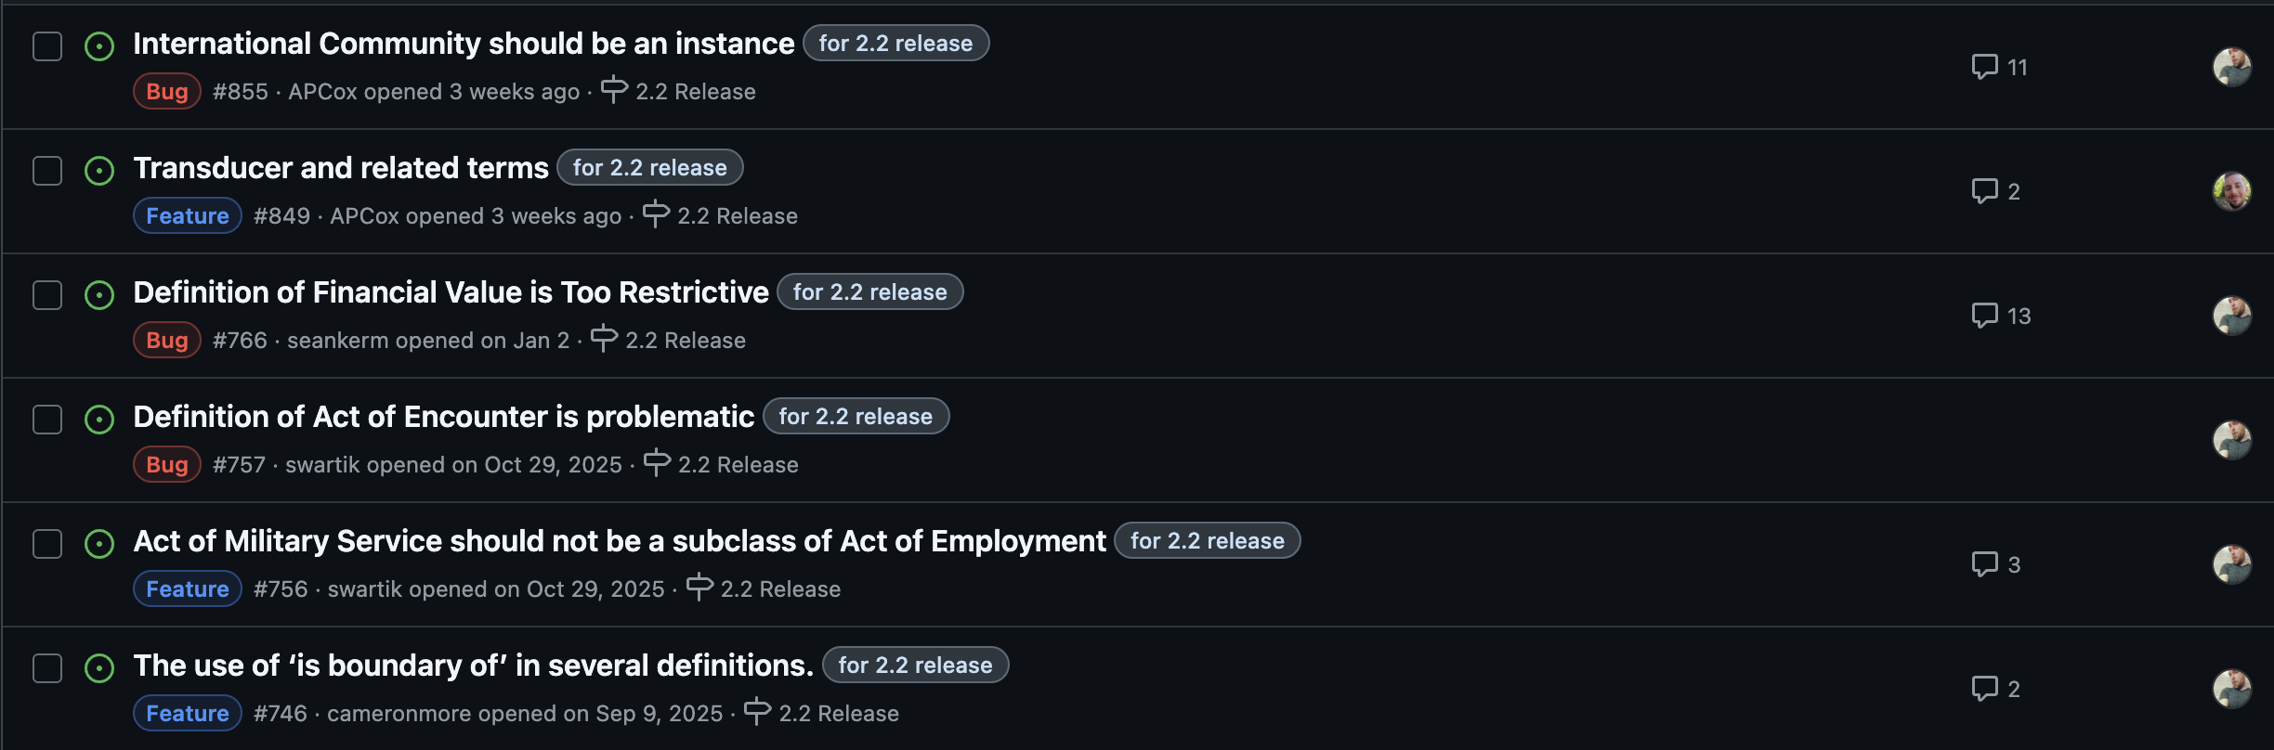
CCO Issue Tracker
https://github.com/CommonCoreOntology/CommonCoreOntologies/issues

Slide 25
ID | Deliverable | Description | Acceptance Criteria
1A-1 | CCO Release 2.1 | 2.1 release of CCO reflecting prioritized fixes, corrections, and updates identified during transition | Release published with version tag, release notes, and reproducible build
1A-2 | Issue Tracker Triage | Systematic review of existing GitHub issues, including resolution, deferral, or closure with rationale | ≥70–80% of legacy issues resolved or dispositioned; labels standardized
1A-3 | Public Project Board | GitHub Projects board tracking milestones, issues, and releases | Board publicly accessible and updated weekly
1A-4 | Domain Extension 1 | At least one domain-specific extension module scoped, implemented, and integrated with core CCO | Module versioned, documented, and released alongside CCO 2.1 and QC-covered
1A-5 | Biweekly Office Hours | Regular stakeholder support sessions addressing modeling, usage, and transition questions | Sessions held; questions documented and summarized, hosted on website
1A-6 | QC Automation Baseline | Initial CI/CD pipeline implementing automated ontology quality checks (OWL, SHACL, SPARQL, etc.) | Automated checks run on PRs and main branch

Slide 26
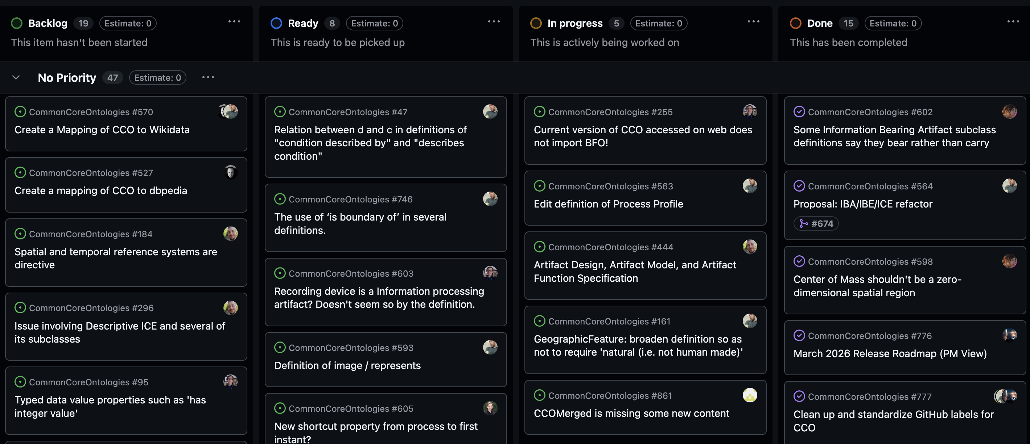
CCO Project Board
https://github.com/orgs/CommonCoreOntology/projects/1

Slide 27
ID | Deliverable | Description | Acceptance Criteria
1A-1 | CCO Release 2.1 | 2.1 release of CCO reflecting prioritized fixes, corrections, and updates identified during transition | Release published with version tag, release notes, and reproducible build
1A-2 | Issue Tracker Triage | Systematic review of existing GitHub issues, including resolution, deferral, or closure with rationale | ≥70–80% of legacy issues resolved or dispositioned; labels standardized
1A-3 | Public Project Board | GitHub Projects board tracking milestones, issues, and releases | Board publicly accessible and updated weekly
1A-4 | Domain Extension 1 | At least one domain-specific extension module scoped, implemented, and integrated with core CCO | Module versioned, documented, and released alongside CCO 2.1 and QC-covered
1A-5 | Biweekly Office Hours | Regular stakeholder support sessions addressing modeling, usage, and transition questions | Sessions held; questions documented and summarized, hosted on website
1A-6 | QC Automation Baseline | Initial CI/CD pipeline implementing automated ontology quality checks (OWL, SHACL, SPARQL, etc.) | Automated checks run on PRs and main branch

Slide 28
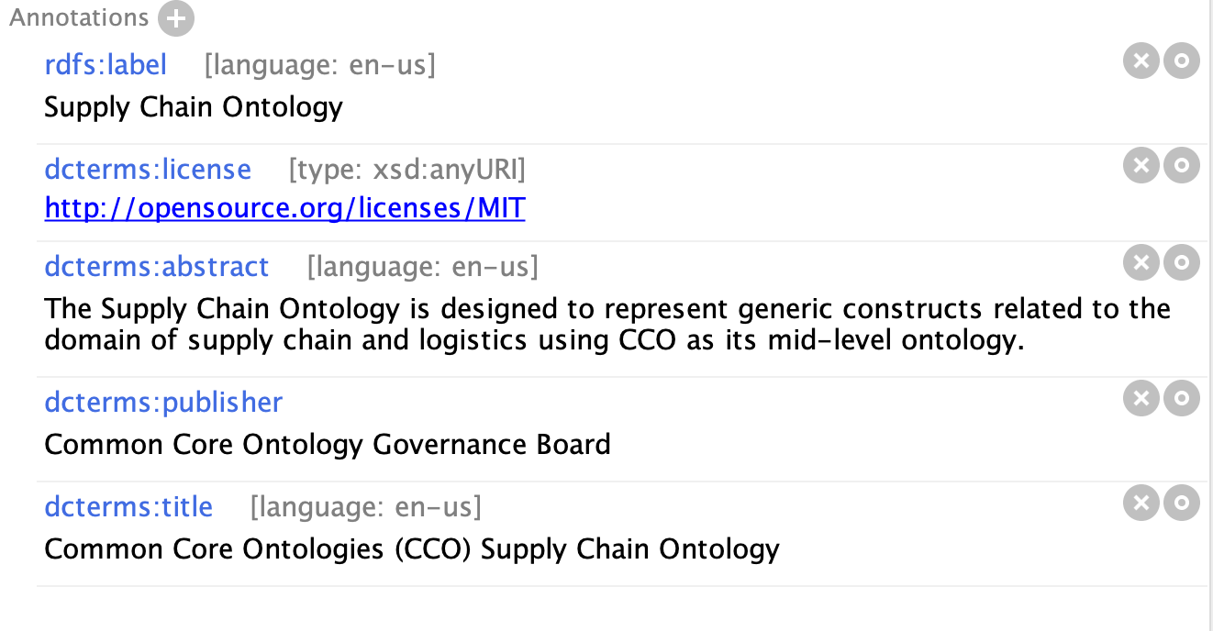
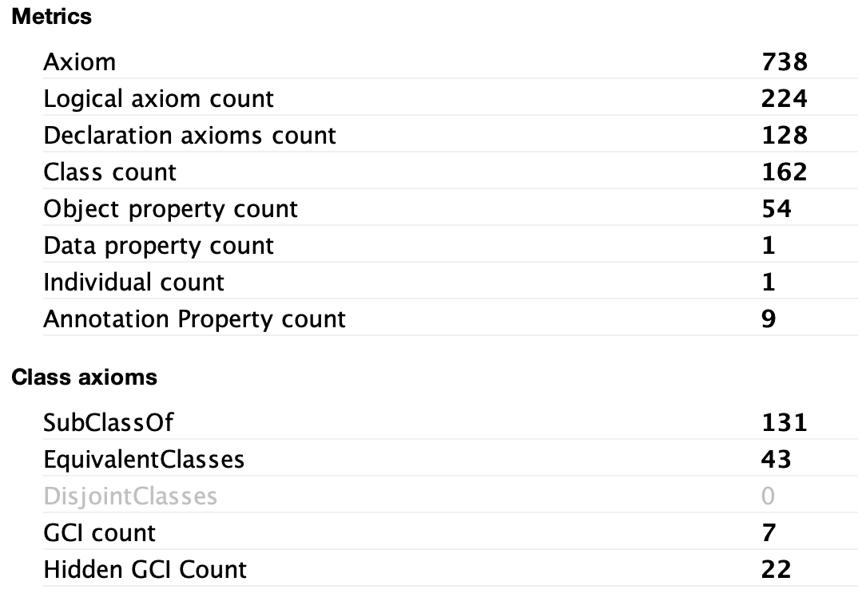
Domain Extension

Slide 29
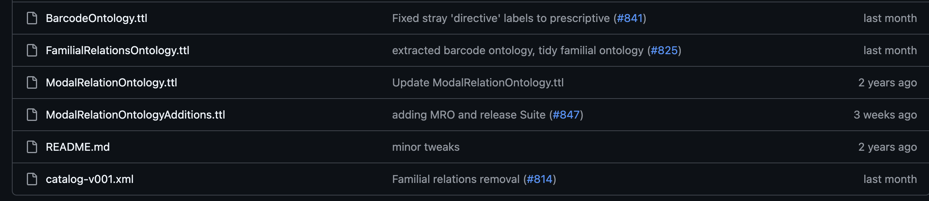
Domain Extension(s)
https://github.com/CommonCoreOntology/CommonCoreOntologies/tree/develop/src/cco-extensions

Slide 30
ID | Deliverable | Description | Acceptance Criteria
1A-1 | CCO Release 2.1 | 2.1 release of CCO reflecting prioritized fixes, corrections, and updates identified during transition | Release published with version tag, release notes, and reproducible build
1A-2 | Issue Tracker Triage | Systematic review of existing GitHub issues, including resolution, deferral, or closure with rationale | ≥70–80% of legacy issues resolved or dispositioned; labels standardized
1A-3 | Public Project Board | GitHub Projects board tracking milestones, issues, and releases | Board publicly accessible and updated weekly
1A-4 | Domain Extension 1 | At least one domain-specific extension module scoped, implemented, and integrated with core CCO | Module versioned, documented, and released alongside CCO 2.1 and QC-covered
1A-5 | Biweekly Office Hours | Regular stakeholder support sessions addressing modeling, usage, and transition questions | Sessions held; questions documented and summarized, hosted on website
1A-6 | QC Automation Baseline | Initial CI/CD pipeline implementing automated ontology quality checks (OWL, SHACL, SPARQL, etc.) | Automated checks run on PRs and main branch

Slide 31
ID | Deliverable | Description | Acceptance Criteria
1A-1 | CCO Release 2.1 | 2.1 release of CCO reflecting prioritized fixes, corrections, and updates identified during transition | Release published with version tag, release notes, and reproducible build
1A-2 | Issue Tracker Triage | Systematic review of existing GitHub issues, including resolution, deferral, or closure with rationale | ≥70–80% of legacy issues resolved or dispositioned; labels standardized
1A-3 | Public Project Board | GitHub Projects board tracking milestones, issues, and releases | Board publicly accessible and updated weekly
1A-4 | Domain Extension 1 | At least one domain-specific extension module scoped, implemented, and integrated with core CCO | Module versioned, documented, and released alongside CCO 2.1 and QC-covered
1A-5 | Biweekly Office Hours | Regular stakeholder support sessions addressing modeling, usage, and transition questions | Sessions held; questions documented and summarized, hosted on website
1A-6 | QC Automation Baseline | Initial CI/CD pipeline implementing automated ontology quality checks (OWL, SHACL, SPARQL, etc.) | Automated checks run on PRs and main branch

Slide 33
Outline
CCO Governance Board & NCOR
CCO Modernization Effort
CCO Future Release Strategy

Slide 36
ID | Deliverable | Description | Acceptance Criteria
1B-1 | CCO Release 2.2 | Refined release incorporating feedback from Phase 1A and remaining transition fixes | Release tagged; change log finalized
1B-2 | Revised Core Modeling Decisions Document | Explicit documentation of key modeling choices and constraints, e.g. design patterns and explanations | Published in repo and website
1B-3 | Domain Extension 2 | Second domain module generated; maintenance for domain extension 1 | Versioned, documented, and QC-covered and QC-covered for domain extensions 1-2
1B-4 | NSOF Governance Alignment Plan | Document describing how CCO aligns with and can inform NSOF governance, releases, and contribution processes | Approved internally and shared with NSOF
1B-5 | QC Expansion | Expanded automated checks covering CCO and modules | ≥75% coverage of CCO 2.2 and module content, with QCs running in CI
1B-6 | Biweekly Office Hours | Regular stakeholder support sessions addressing modeling, usage, and transition questions | Sessions held; questions documented and summarized, hosted on website

Slide 37
ID | Deliverable | Description | Acceptance Criteria
1B-1 | CCO Release 2.2 | Refined release incorporating feedback from Phase 1A and remaining transition fixes | Release tagged; change log finalized
1B-2 | Revised Core Modeling Decisions Document | Explicit documentation of key modeling choices and constraints, e.g. design patterns and explanations | Published in repo and website
1B-3 | Domain Extension 2 | Second domain module generated; maintenance for domain extension 1 | Versioned, documented, and QC-covered and QC-covered for domain extensions 1-2
1B-4 | NSOF Governance Alignment Plan | Document describing how CCO aligns with and can inform NSOF governance, releases, and contribution processes | Approved internally and shared with NSOF
1B-5 | QC Expansion | Expanded automated checks covering CCO and modules | ≥75% coverage of CCO 2.2 and module content, with QCs running in CI
1B-6 | Biweekly Office Hours | Regular stakeholder support sessions addressing modeling, usage, and transition questions | Sessions held; questions documented and summarized, hosted on website
JUNE 30 2026

Slide 38
Future Releases
For forthcoming releases NCOR will:
Align more closely with the CCO Developer Group
Post regular reminders about upcoming changes and dates
Approximately one week in advance of a release, create a ‘release branch’ for stakeholder review
Aggressively disseminate information about any perceived breaking changes, as well as remediation strategies
Publish training and implementation documentation in the repo

Slide 39
ID | Deliverable | Description | Acceptance Criteria
1B-1 | CCO Release 2.2 | Refined release incorporating feedback from Phase 1A and remaining transition fixes | Release tagged; change log finalized
1B-2 | Revised Core Modeling Decisions Document | Explicit documentation of key modeling choices and constraints, e.g. design patterns and explanations | Published in repo and website
1B-3 | Domain Extension 2 | Second domain module generated; maintenance for domain extension 1 | Versioned, documented, and QC-covered and QC-covered for domain extensions 1-2
1B-4 | NSOF Governance Alignment Plan | Document describing how CCO aligns with and can inform NSOF governance, releases, and contribution processes | Approved internally and shared with NSOF
1B-5 | QC Expansion | Expanded automated checks covering CCO and modules | ≥75% coverage of CCO 2.2 and module content, with QCs running in CI
1B-6 | Biweekly Office Hours | Regular stakeholder support sessions addressing modeling, usage, and transition questions | Sessions held; questions documented and summarized, hosted on website

Slide 40
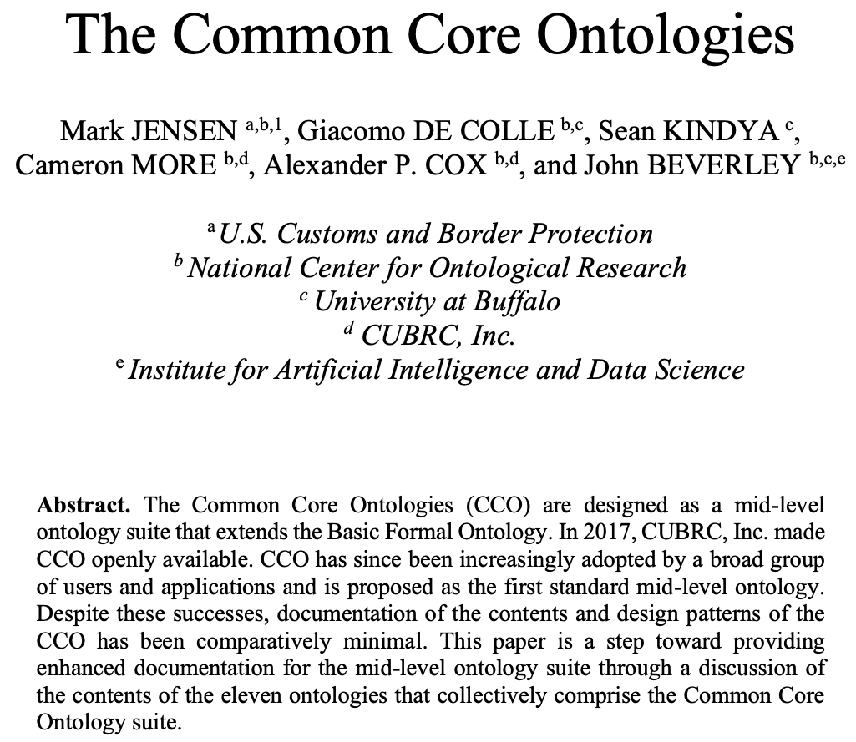
https://www.utwente.nl/en/eemcs/fois2024/resources/papers/jensen-et-al-the-common-core-ontologies.pdf

Slide 41
ID | Deliverable | Description | Acceptance Criteria
1B-1 | CCO Release 2.2 | Refined release incorporating feedback from Phase 1A and remaining transition fixes | Release tagged; change log finalized
1B-2 | Revised Core Modeling Decisions Document | Explicit documentation of key modeling choices and constraints, e.g. design patterns and explanations | Published in repo and website
1B-3 | Domain Extension 2 | Second domain module generated; maintenance for domain extension 1 | Versioned, documented, and QC-covered and QC-covered for domain extensions 1-2
1B-4 | NSOF Governance Alignment Plan | Document describing how CCO aligns with and can inform NSOF governance, releases, and contribution processes | Approved internally and shared with NSOF
1B-5 | QC Expansion | Expanded automated checks covering CCO and modules | ≥75% coverage of CCO 2.2 and module content, with QCs running in CI
1B-6 | Biweekly Office Hours | Regular stakeholder support sessions addressing modeling, usage, and transition questions | Sessions held; questions documented and summarized, hosted on website

Slide 43
ID | Deliverable | Description | Acceptance Criteria
2-1 | CCO Release 3.0 | First stable release reflecting refined modeling, patterns, and governance | Versioned release with documentation; full formal axiomatizations in OWL, JSON-LD, and CLIF formats
2-2 | CCO 3.0 Design Pattern Library | Updated, curated design patterns aligned with CCO 3.0 | Published in repo and website and referenced in docs
2-3 | Domain Extension 3 & 4 | Third and fourth domain module generated; maintenance for domain extensions 1 and 2 | Versioned, documented, and QC-covered and QC-covered for domain extensions 1-4
2-4 | IOF Alignment Artifacts | Mapping or alignment documentation between CCO and Industrial Ontology Foundry artifacts | Publicly available mapping artifacts
2-5 | CCO Video Series | Instructional videos covering CCO fundamentals and updates | At least 5 videos published on CCO YouTube channel, captioned
2-6 | Updated CCO Website & Documentation | Existing website updated to training hub portal, access to lectures, quizzes, FAQs, etc. | Website live and maintained
2-9 | Multilingual Support | Develop a proof-of-concept for multilingual support, focusing on one or two priority languages. | CCO 3.0 overlay file with priority language definitions, labels, alternative labels, and documentation
DEC 31 2026

Slide 45
ID | Deliverable | Description | Acceptance Criteria
3-1 | Stable CCO Release 4.0 | Stabilized low-volatility release | Release designated as stable
3-2 | Complete Design Pattern & Documentation Suite | Finalized modeling guidance for stabilized CCO 4.0 | Docs complete and versioned
3-3 | Training & Certification Materials | Videos, certification, quizzes, FAQs, and learning materials reflecting CCO 4.0; documented user feedback | Training portal operational and evaluated by users
3-4 | External Standards Alignments | Alignment with GeoSPARQL, QUDT, Time, NIEM, etc. | Alignment docs published
3-5 | Domain Extension 5 & 6 | Fifth and sixth domain module generated; maintenance on domain extensions 1-4 | Versioned, documented, and QC-covered for domain extensions 1-6
3-7 | Multilingual Support | Refine pilot and expand multilingual support, focusing on two additional languages. | CCO 4.0 overlay file with relevant language definitions, labels, alternative labels, and documentation
3-8 | DoD/IC Pilot Integration Study | Pilot demonstrating CCO use in ISR or AI/ML pipelines | Study report delivered
3-9 | Stakeholder Summary & Forward Plan | Report summarizing stabilization and future roadmap | Delivered to sponsors
JUNE 30 2027

Slide 47
ID | Deliverable | Description | Acceptance Criteria
N-1 | Maintenance Release(s) | Minor updates, fixes, and improvements | Releases published
N-2 | Domain Extension N | New domain modules generated | Versioned, documented, and QC-covered
N-3 | Expanded QC Coverage | QC automation extended to new domains | CI coverage increased across new and updated domain module extensions of CCO 4.0
N-4 | Multilingual Expansion | Additional languages supported | New language annotations stored in respective overlay files based on CCO 4.0
N-5 | User Support & Office Hours | Continued engagement and support | SLAs met (responses within 72 hours)
N-6 | Metrics & Activity Report | Usage, adoption, and repo analytics | Report delivered
N-8 | Publications | Continued dissemination of CCO 4.0 and domain extension features, applications, and use cases | Journal publications, proceedings, white papers, presentations, briefs

Slide 48
What to Tell Your Sponsors
Cleanup of artifacts and documentation underway, will be completed June 30, 2026
First wave of major structural changes (3.0) to be released by December 31, 2026; will incorporate GeoSPARQL, QUDT, refactoring of information, etc.
Last wave of major structural changes (4.0) to be released June 30, 2027
Recommendation is to update following 4.0 release

Slide 49
What to Tell Your Sponsors
This is at present an ACC-funded effort and as a consequence, AF use cases for domain extensions are prioritized
Agencies with use cases they would like to see represented are welcome to provide and NCOR will make efforts to accommodate
Agencies that would like to see their use cases prioritized will need to contribute resources (e.g. people, funds, etc.) to the modernization project

